Slide 1
Subtopic N1.12– Rounding to decimal places
LEARNING OUTCOME: To round numbers to 1, 2 or 3 decimal places.
Objectives:
Keywords:
Rounding
Integer
Accuracy
To be able to round to 1, 2 or 3 decimal places using a number line
To be able to round to 1, 2 or 3 decimal places without a number line
Introduction – Read and annotate:
Rounding decimals helps us find the closest value at a given point, such as the nearest tenth or
hundredth, making numbers easier to work with while keeping them accurate. This builds on the
previous rounding subtopic, understanding of decimal place value, estimating positions on a number
line, and recognising midpoints to decide which way to round correctly. Rounding decimals is an
important skill that will help in future topics like measurements and money calculations. It also
improves our ability to estimate answers quickly and check if calculations are reasonable.
Definition
Characteristics
The process of finding an approximation for a number to a given accuracy.
Numbers round up or down depending on the value they are closer to (and exactly halfway between rounds up).
The number of decimal places of a number are the number of digits after the decimal point.
Examples
Rounding
Non - Examples
6.3802 = 6.4 to 1 decimal place
6.3802 = 6.38 to 2 decimal places
6.3802 = 6.380 to 3 decimal places
6.3802 ≠ 6.3 to 1 decimal place
6.3802 ≠ 638 to 2 decimal places
6.3802 ≠ 6.38 to 3 decimal places
Use a number line to identify the nearest numbers to 1 decimal place and round
Example 1 - I do…
Example 2 – We do…
Example 3 – You do…
Steps | Draw a number line showing the numbers with 1 decimal place above and below 8.571 | Draw a number line showing the numbers with 1 decimal place above and below 23.92 | Draw a number line showing the numbers with 1 decimal place above and below 1.26
1) Identify 1dp above and 1dp below. 2) Is it closer to the 1dp above or the 1dp below? | 8.5 8.6 | 23.9 24 | 1.2 1.3
 | Round 8.571 to 1 decimal place (1dp) | Round 23.92 to 1 decimal place (1dp) | Round 1.26 to 1 decimal place (1dp)
 | 8.6 | 23.9 | 1.3
‹#›

Slide 2
Independent Practice
1. Identify the numbers with 1 decimal place above and below each number. , then round to the nearest 1 decimal place.
a) | b) | e)
d) 7.31 | e) 16.48 | f) 8.342
g) 10.25 | h) 10.251 | i) 10.98
6.8
6.87
6.9
8.9
8.93
9
7.5
7.554
7.6
7.3
7.4
16.4
16.5
8.3
8.4
7.3 16.5 8.3
10.2
10.3
11.0
10.2
10.3
10.9
10.3 10.3 11.0
Round each number to 1 decimal place.
a) 9.77 | b) 3.14 | c) 5.191 | d) 39.555 | e) 9.99
f) 93.2941 | g) 10.087 | h) 0.831 | i) 0.54868696 | j) 62.89
9.8 3.1 5.2 39.6 10.0
93.3 10.1 0.8 0.5 62.9
Use a number line to identify the nearest numbers to 2 or 3 decimal places and round
Example 4 - I do…
Example 5 – We do…
Example 6 – You do…
Steps | Round 6.482 to 2 decimal places, by drawing a number line | Round 9.3205 to 2 decimal places, by drawing a number line | Round 35.647 to 2 decimal places, by drawing a number line
1) Identify the dp above and the dp below. 2) Is it closer to the dp above or the dp below? | 6.48 6.49 | 9.32 9.33 | 35.64 35.65
 | Round 6.4821 to 3 decimal places, by drawing a number line | Round 9.3205 to 3 decimal places, by drawing a number line | Round 35.6487 to 3 decimal places, by drawing a number line
 | 6.482 6.483 | 9.320 9.321 | 35.648 35.649
6.48
9.32
35.65
9.321
35.649
6.482
‹#›

Slide 3
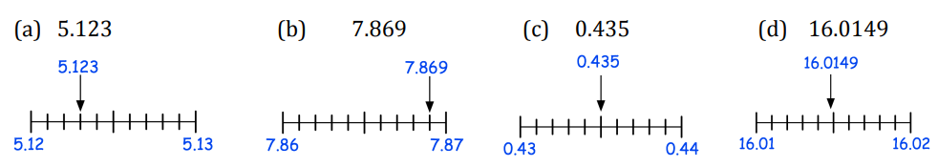
Independent Practice
3. For a) to d), identify the numbers with 2 decimal places above and below each number, then round to the nearest 2dp. For e) to i), do the same but for 3dp.
a) | b) | e)
d) | e) 5.1234 | f) 0.3562
g) 70.9545 | h) 9.30872 | i) 9.30972
5.12 7.87 0.44
16.01
5.124
5.123
0.357
0.356
5.123
0.356
70.954
70.955
9.309
9.310
9.308
9.309
9.310
70.955
9.309
4. Round each number to 2 decimal places.
a) 3.487 | b) 2.613 | c) 1.984 | d) 10.046 | e) 8.155
f) 19.367 | g) 3.141 | h) 6.0698 | i) 4.26317 | j) 93.46197
3.49 2.61 1.98 10.05 8.16
19.37 3.14 6.07 4.26 93.46
5. Round each number to 2 decimal places.
a) 0.0346 | b) 6.7568 | c) 4.2251 | d) 1.7583
e) 40.48546 | f) 128.01891 | g) 0.5059802 | h) 384.456094
0.035 6.757 4.225 1.758
40.485 128.019 0.506 384.456
Round to a given accuracy without a number line
Example 7 - I do…
Example 8 – We do…
Example 9 – You do…
Steps | Round 7.4754 to 3 decimal places | Round 7.4754 to 2 decimal places | Round 7.4754 to 1 decimal place
Identify the digit to the right of the decimal place you want to round to. If it is 5 or above, round up. If it is below 5, keep it the same. | 7.475 | 7.48 | 7.5
‹#›

Slide 4
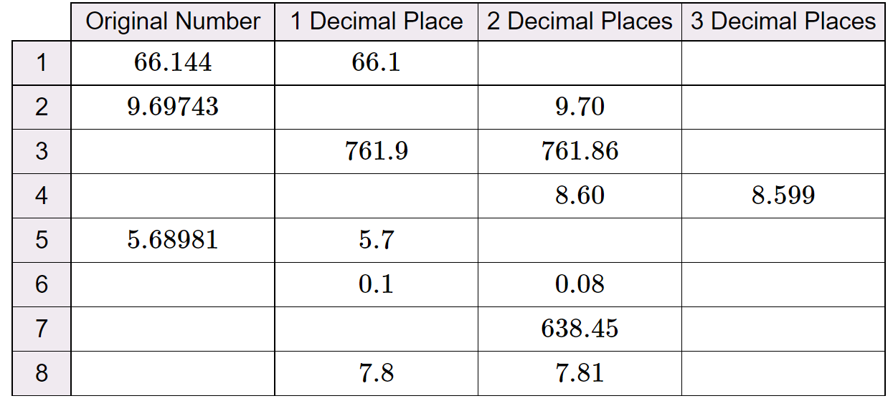
Independent Practice
6. Round each number to the required degree of accuracy.
a) 3.47 (1dp) | b) 0.11 (1dp) | c) 9.84 (1dp) | d) 12.75 (1dp)
e) 7.546 (1dp) | f) 10.8691 (2dp) | g) 9.3862 (3dp) | h) 7.3093 (1dp)
i) 0.0064 (3dp) | j) 95.02 (1dp) | k) 32.9745 (2dp) | l) 0.4795 (3dp)
3.5 0.1 9.8 12.8
7.5
10.87
9.386
7.3
0.006
95.0
32.97
0.480
7. Round each of the numbers below to the given accuracy.
Number | Rounded to 1 decimal place | Rounded to 2 decimal places | Rounded to 3 decimal places
78.2079 | 78.2 | 78.21 | 78.108
5.3254 | 5.3 | 5.33 | 5.325
0.38294 | 0.4 | 0.38 | 0.383
10.0359 | 10.0 | 10.04 | 10.036
40.6666 | 40.7 | 40.67 | 40.667
9.99999 | 10.0 | 10.00 | 10.000
8. A number rounds to 1.5 (1 decimal place), 1.47 (2 decimal places) and 1.465 (3 decimal places). Fill in the table with ticks and crosses to show which of these numbers satisfy these conditions
Original number | Rounds to 1.5 to 1 dp | Rounds to 1.47 to 2 dp | Rounds to 1.465 to 3 dp
1.468 | ✓ | ✓ | X
1.4653 | ✓ | ✓ | ✓
1.4649 | ✓ | X | ✓
9. Complete the table. There are some boxes with more than one correct option.
66.14 66.144
9.7 9.697
e.g. 761.863 e.g. 761.863
e.g. 8.5991 8.6
5.69 5.690
e.g. 0.0836 e.g. 0.084
e.g. 638.4471 e.g. 638.4 e.g. 638.447
e.g. 7.8142 e.g. 7.814
‹#›
‹#›

